Slide 1
EDA
(Exploratory Data Analysis )

Slide 2
Outlines
Introduction to Exploratory Data Analysis (EDA)
Steps in EDA
Data Types
Data Transformation
Introduction to Missing data, handling missing data Data Visualization using Matplotlib, Seaborn

Slide 3
Introduction
EDA is a crucial step in the data analysis process.
It involves investigating datasets to summarize their main characteristics, often using visual methods. It uses graphs and stats to find patterns and weird things in the data without guessing or proving anything.
EDA helps in understanding the data structure, detecting anomalies, discovering patterns, and checking assumptions, all of which inform further analysis.
By checking each piece of data and how they relate, EDA helps us understand what’s in the data. As well as decide what to do next.
It’s like a guide that helps us make sense of all the information we have, so we can make smart decisions.

Slide 4
Steps in eda
1- Understand the Data Structure
- Data Collection
-Data Description
2-Data Cleaning
-Handling Missing Values
-Removing Duplicates
-Data Correction
-Outlier Detection
3-Data Transformation
-Feature Engineering
-Normalization/Standardization
-Encoding Categorical Variables

Slide 5
4-Data Visualization
-Univariate Analysis-histograms, box plots, and density plots
-Bivariate Analysis-scatter plots, correlation matrices, and line charts
-Multivariate -Analysis-pair plots and heat maps
5-Data Summarization-
Descriptive Statistics- mean, mode, median
Correlation Analysis- correlation, covariance
Distribution Analysis- normal distribution
6-Data Interpretation
Pattern Recognition
Hypothesis Testing
7-Report Findings-Summarize insights and findings from the EDA process.

Slide 6
Data Types
1.Numerical Data-
  Continuous
  Discrete
2.Categorical Data
  Nominal:
  ordinal
3.Binary Data
4.Text Data
5.Time Series Data
Date/Time Data

Slide 7
Data Transformation

Slide 8
Data Transformation
Data transformation is a crucial step in the Exploratory Data Analysis (EDA) process.
It involves converting data into a suitable format or structure to improve its quality and usability.
This can help to uncover hidden patterns, identify anomalies, and ensure that the data is ready for modeling.

Slide 9
Benefits of Data Transformation
Improved Model Performance
Enhanced Data Visualizations
Handling Outliers
Better Convergence-Faster Training, Stability, better Performance
Dimensionality Reduction
Better Insights from Feature Engineering

Slide 10
Disadvantages
Information Loss
Risk of Overfitting
Data Leakage
Increased Complexity
Assumption Violation

Slide 11
Transformation Techniques
Normalization and Standardization
Log Transformation
3. Box-Cox Transformation
Square Root and Cube Root Transformations
Categorical Encoding
6. Binning or Discretization
7. Handling Missing Values
8. Scaling
9. Feature Engineering
10. Dimensionality Reduction

Slide 12
Normalization and Standardization
Are two common techniques in machine learning for scaling or transforming features, especially when working with data that vary significantly in magnitude or units.
Proper scaling often improves model performance, particularly in algorithms that are sensitive to feature magnitudes, such as gradient-based models and distance-based models.

Slide 13
Normalization
Normalization typically refers to scaling the features to a specific range, usually [0, 1] or [-1, 1].
This ensures that the values of all features lie within a uniform range, preserving the relationships among data points while changing their scale.
Formula:
Xnorm= X−Xmin/ Xmax−Xmin
Where:
X is the original feature value,
Xmin​ and Xmax are the minimum and maximum values of the feature.

Slide 14
Standardization
Standardization involves transforming the features to have a mean of 0 and a standard deviation of 1. This process shifts the distribution of the data so that it is centered around 0, with unit variance. It is particularly useful when features have different units or are distributed on vastly different scales.
Formula:
Xstd= X−μ/σ​
Where:
μ is the mean of the feature,
σ is the standard deviation of the feature.

Slide 15

Discretization and binning
Binning (or discretization) is the process of converting continuous data into discrete bins or categories.
It is often used in data analysis and preprocessing to simplify the data, reduce the effects of small observation errors, and make patterns more visible.
Binning can also help in handling skewed data and outliers, improving the performance of some machine learning models.

Slide 16
Types of Binning
Fixed-width Binning (Equal-width Binning)-
Divides the range of data into intervals (bins) of equal size.
Example: If you have a continuous range of data from 0 to 100 and you decide to use 5 bins, each bin would have a width of 20 (0-20, 20-40, 40-60, 60-80, 80-100).
2. Quantile Binning (Equal-frequency Binning)-
Divides the data into bins so that each bin contains an equal number of data points.
Example: For a dataset of 100 values, if you create 4 bins using quantile binning, each bin will have 25 values

Slide 17
3.Custom Binning-
The user defines the bin edges based on domain knowledge or specific requirements.
Example: Age categories like 0-18 (child), 19-35 (young adult), 36-60 (middle-aged), 61+ (senior).
4. K-Means Binning-
Uses clustering techniques, like K-Means, to create bins where data points in each bin are similar.
This method is less common but can be useful for creating bins with similar properties.

Slide 18
Advantages of Binning
Simplification
Handling Outliers
Improved Model Interpretability
Data Normalization
Disadvantages of Binning
Loss of Information
Choice of Bins
Introduces Bias

Slide 19
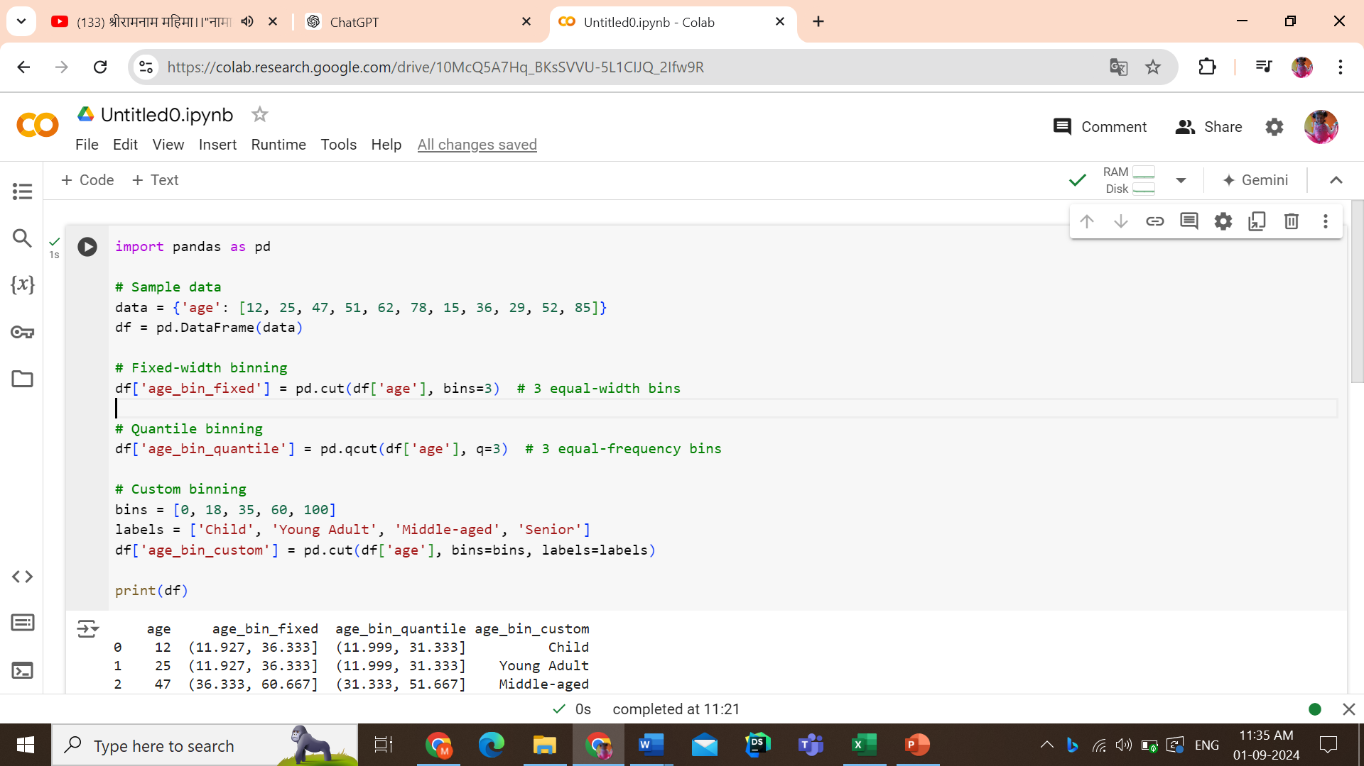

Slide 20
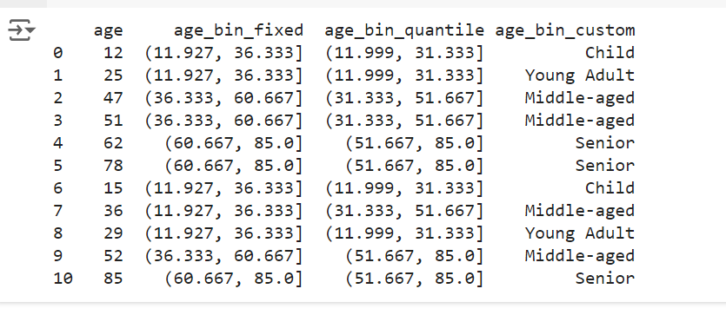
output

Slide 21
Introduction to Missing data, handling missing data

Slide 22
Introduction to Missing Data
Missing data is a common issue in data analysis, where certain values or observations are absent from a dataset.
This can happen for various reasons, such as human error, data entry problems, or sensor malfunctions.
Missing data can significantly affect the quality of the analysis and the performance of machine learning models.

Slide 23
Identifying Missing Data:
Visualization: Use heatmaps, bar plots, or matrix plots to visualize the distribution and pattern of missing data.
Summary Statistics: Use functions like .isnull().sum() in pandas to count missing values per column.

Slide 24
Handling Missing Data:
Removing Missing Data:
Dropping Rows: Remove rows with missing data if the proportion of missing data is small.
Dropping Columns: Remove columns with a high proportion of missing values, especially if they are not critical to the analysis.
Example- df.dropna()

Slide 25
import pandas as pd
import numpy as np
from sklearn.impute import SimpleImputer
# Create a sample DataFrame with missing values
data = {'Name': ['Alice', 'Bob', 'Charlie', 'David', 'Eve'],
'Age': [24, np.nan, 22, 30, np.nan],
'Salary': [50000, 54000, np.nan, 60000, 59000]}
df = pd.DataFrame(data)
# Show the data with missing values
print("Original Data:")
print(df)

Slide 26
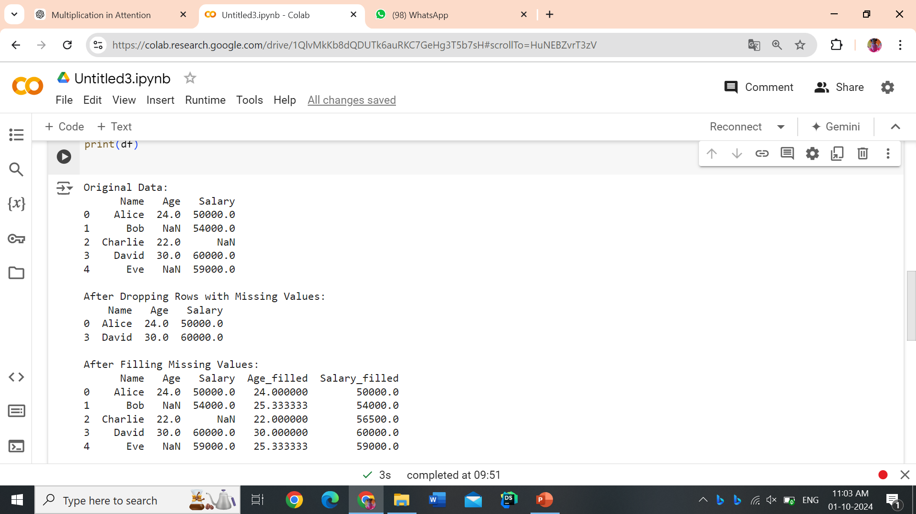
Output

Slide 27
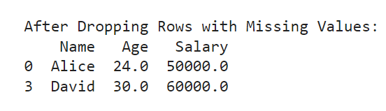
# Option 1: Drop rows with missing values
df_dropped = df.dropna()
print("\nAfter Dropping Rows with Missing Values:")
print(df_dropped)
OUTPUT

Slide 28
Drop column
# Drop the 'Salary' column
df_dropped = df.drop('Salary', axis=1)
print(df_dropped)

Slide 29

# Option 2: Fill missing values with a specific value (e.g., mean, median)
# Filling missing 'Age' with the mean value
df['Age_filled'] = df['Age'].fillna(df['Age'].mean())
# Filling missing 'Salary' with the median value
df['Salary_filled'] = df['Salary'].fillna(df['Salary'].median())
print("\nAfter Filling Missing Values:")
print(df)

Slide 30
Imputation:
Mean/Median/Mode Imputation: Replace missing values with the mean, median, or mode of the column. This is simple but can introduce bias.
Forward/Backward Fill: Fill missing values using the previous (forward fill) or next (backward fill) values. This is useful for time-series data.
Interpolation: Estimate missing values by interpolating between existing values.
Example: df.fillna(df.mean())
in pandas to fill missing values with the mean.

Slide 31
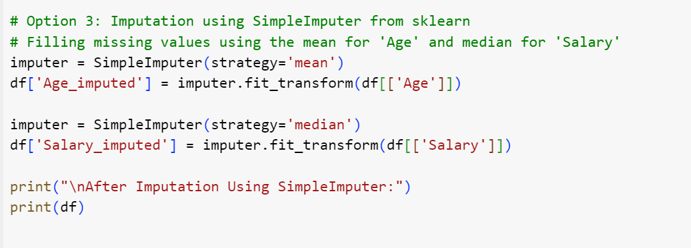

Slide 32
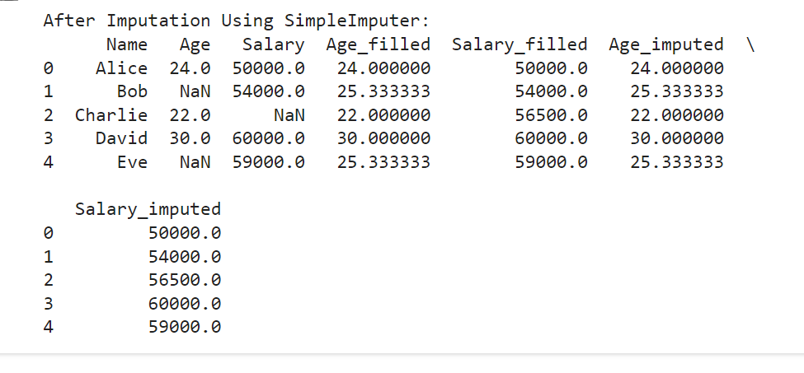

Slide 33
Data Visualization using Matplotlib, Seaborn
Line plot
Scatter Plot
Heat Map
Box plot

Slide 34
Normalization and standardization

Slide 35
import pandas as pd
import numpy as np
from sklearn.preprocessing import MinMaxScaler, StandardScaler
# Sample dataset
data = {'Age': [25, 30, 22, 35, 28],
'Salary': [50000, 60000, 52000, 80000, 55000]}
df = pd.DataFrame(data)
# Display original data
print("Original Data:")
print(df)
OUTPUT
Age Salary
0 25 50000
1 30 60000
2 22 52000
3 35 80000
4 28 55000

Slide 36
Normalization
# === Normalization using MinMaxScaler === #
# Create a MinMaxScaler object
min_max_scaler = MinMaxScaler()
# Apply normalization to the dataset
normalized_data = min_max_scaler.fit_transform(df)
# Convert the result back to a DataFrame
df_normalized = pd.DataFrame(normalized_data, columns=df.columns)
print("\nNormalized Data (MinMaxScaler):")
print(df_normalized)
OUTPUT
Age Salary
0 0.230769 0.000000
1 0.615385 0.500000
2 0.000000 0.100000
3 1.000000 1.000000
4 0.461538 0.166667

Slide 37
standardization
# === Standardization using StandardScaler === #
# Create a StandardScaler object
standard_scaler = StandardScaler()
# Apply standardization to the dataset
standardized_data = standard_scaler.fit_transform(df)
# Convert the result back to a DataFrame
df_standardized = pd.DataFrame(standardized_data, columns=df.columns)
print("\nStandardized Data (StandardScaler):")
print(df_standardized)
OUTPUT
Age Salary
0 -0.707107 -1.149082
1 0.707107 -0.229816
2 -1.414214 -1.034466
3 1.414214 1.609073
4 0.000000 -0.804291

Slide 38
Forward fill
import pandas as pd
import numpy as np
# Sample DataFrame with missing values
data = {'Date': ['2023-10-01', '2023-10-02', '2023-10-03', '2023-10-04', '2023-10-05'],
'Value': [10, np.nan, 20, np.nan, 30]}
df = pd.DataFrame(data)
# Display original DataFrame
print("Original DataFrame:")
print(df)
# Apply forward fill to fill missing values
df_ffill = df.fillna(method='ffill')
# Display DataFrame after forward fill
print("\nDataFrame After Forward Fill:")
print(df_ffill)

Slide 39
Original DataFrame:
Date Value
0 2023-10-01 10.0
1 2023-10-02 NaN
2 2023-10-03 20.0
3 2023-10-04 NaN
4 2023-10-05 30.0
DataFrame After Forward Fill:
Date Value
0 2023-10-01 10.0
1 2023-10-02 10.0
2 2023-10-03 20.0
3 2023-10-04 20.0
4 2023-10-05 30.0

Slide 40
Backward Fill
import pandas as pd
import numpy as np
# Sample DataFrame with missing values
data = {'Date': ['2023-10-01', '2023-10-02', '2023-10-03', '2023-10-04', '2023-10-05'],
'Value': [10, np.nan, 20, np.nan, 30]}
df = pd.DataFrame(data)
# Display original DataFrame
print("Original DataFrame:")
print(df)
# Apply backward fill to fill missing values
df_bfill = df.fillna(method='bfill')
# Display DataFrame after backward fill
print("\nDataFrame After Backward Fill:")
print(df_bfill)

Slide 41
output
Original DataFrame:
Date Value
0 2023-10-01 10.0
1 2023-10-02 NaN
2 2023-10-03 20.0
3 2023-10-04 NaN
4 2023-10-05 30.0
DataFrame After Backward Fill:
Date Value
0 2023-10-01 10.0
1 2023-10-02 20.0
2 2023-10-03 20.0
3 2023-10-04 30.0
4 2023-10-05 30.0

Slide 42
Interpolate missing values
In machine learning, interpolating missing values involves filling in the missing data points by estimating their values based on the surrounding data. This can be especially useful when you have time-series or continuous data, where missing values can be inferred from existing data points.

Slide 43
Interpolation Techniques
There are several interpolation techniques, including:
Linear Interpolation: Assumes a straight line between two known points.
Polynomial Interpolation: Fits a polynomial function between the points.
Spline Interpolation: Fits a spline (piecewise polynomial) between points.
Time-based Interpolation: If the index of your data is a time series, this method takes the time spacing into account.

Slide 44
import pandas as pd
import numpy as np
# Create a sample dataframe with missing values
data = {'A': [1, 2, np.nan, 4, 5],
'B': [5, np.nan, np.nan, 8, 10]}
df = pd.DataFrame(data)
print("Original Data:")
print(df)
# Perform linear interpolation
df_interpolated = df.interpolate(method='linear’)
print("\nInterpolated Data (Linear):")
print(df_interpolated)

Slide 45
Data Deduplication
In Machine Learning (ML), data deduplication refers to the process of identifying and removing duplicate data entries from the dataset to ensure that the training data is unique, clean, and efficient for model training.
Redundant or duplicate data can lead to biased models, inefficient training processes, and increased computational overhead.
By eliminating duplicates, deduplication enhances the quality of the dataset, reduces storage requirements, and improves the model's generalization ability.

Slide 46
Common Techniques Used for Data Deduplication
Exact Match Deduplication
Near-Duplicate Matching (Fuzzy Matching)
Hash-Based Deduplication
Feature-Based Deduplication
Clustering-Based Deduplication
Cross-Dataset Deduplication
Image-Based Deduplication (for Computer Vision)
# Example in pandas
df.drop_duplicates(inplace=True)

Slide 47
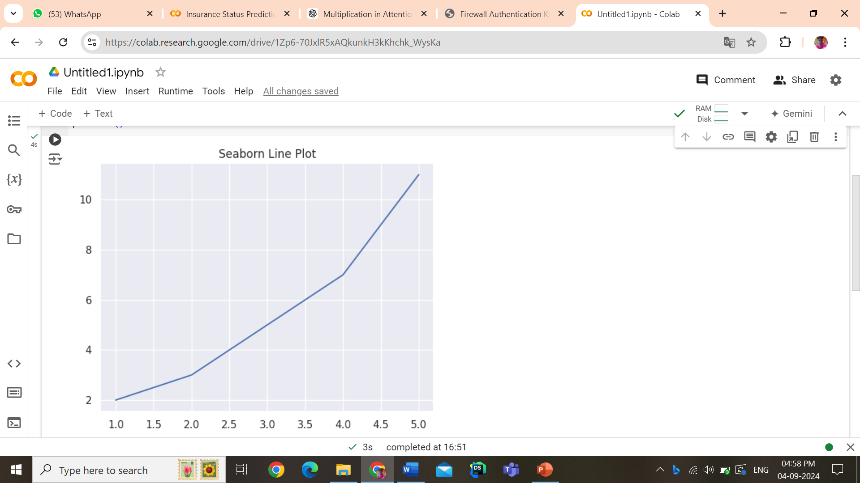
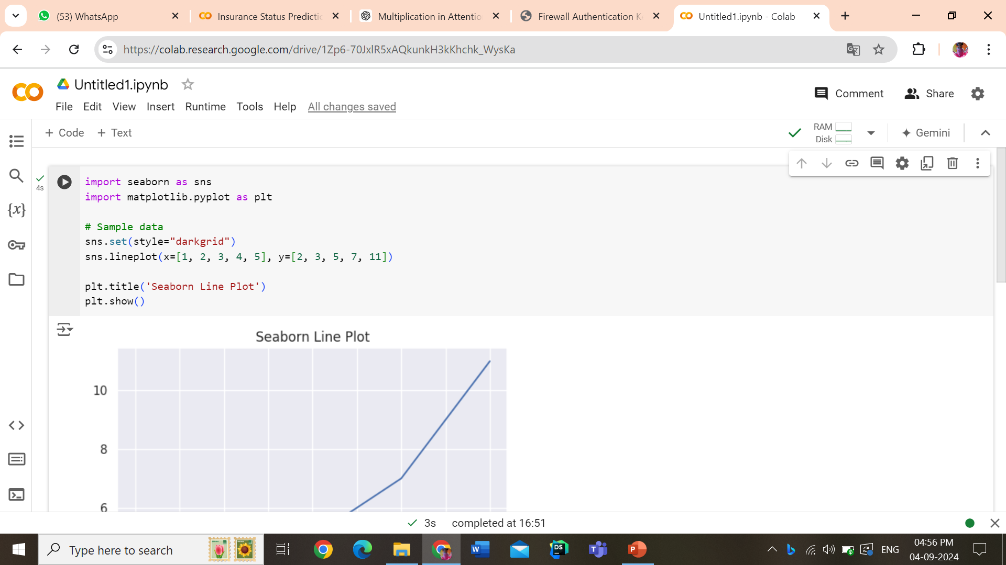

Slide 48
